Slide 1

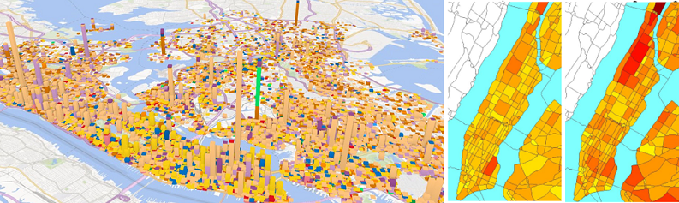
Diagnosing New York City’s Noises with Ubiquitous Data
Dr. Yu Zheng yuzheng@microsoft.com
Lead Researcher, Microsoft Research
Chair Professor at Shanghai Jiao Tong University

Slide 2
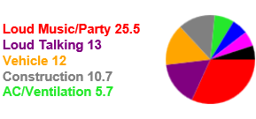
Background
Many cities suffer from noise pollutions
Traffic, loud music, construction, AC…
Compromise working efficiency
Reduce sleep quality
Impair both physical and mental health
…
Urban noise is difficult to model
Change over time very quickly
Vary by location significantly
Depends on sound level and people’s tolerance
The composition of noises is hard to analyze
Yu Zheng, et al. Diagnosing New York City’s Noises with Ubiquitous Data. UbiComp 2014.
Notes:
Many major cities are suffering from noise pollution, which may come from traffic, loud music, and construction.
Urban noise does not only compromise working efficiency and the quality of sleep, but also impair people’s physical and mental health.
Modeling citywide noises, however, is very difficult, as the level of noises varies by locations and changes over time significantly. Noise may disappear in a few seconds.
Moreover, besides the level of sound measured in decibels, the measurement of noise pollution also depends on people’s tolerance to noises, which changes over different times of day. For example, at night, people’s tolerance to noises is much lower than during the daytime. A quieter noise at night may be considered a heavier noise pollution.
Furthermore, urban noises are usually a mixture of multiple sound sources. Understanding the composition of noises, e.g., in evening rush hour, 40 percent of noise in a given place comes from loud music, 30% from vehicle traffic and 10% from constructions, is vital to tackling noise pollution.
Consequently, even if we could deploy sound sensors everywhere, diagnosing urban noise pollution solely based on sensor data is not thorough.

Slide 3
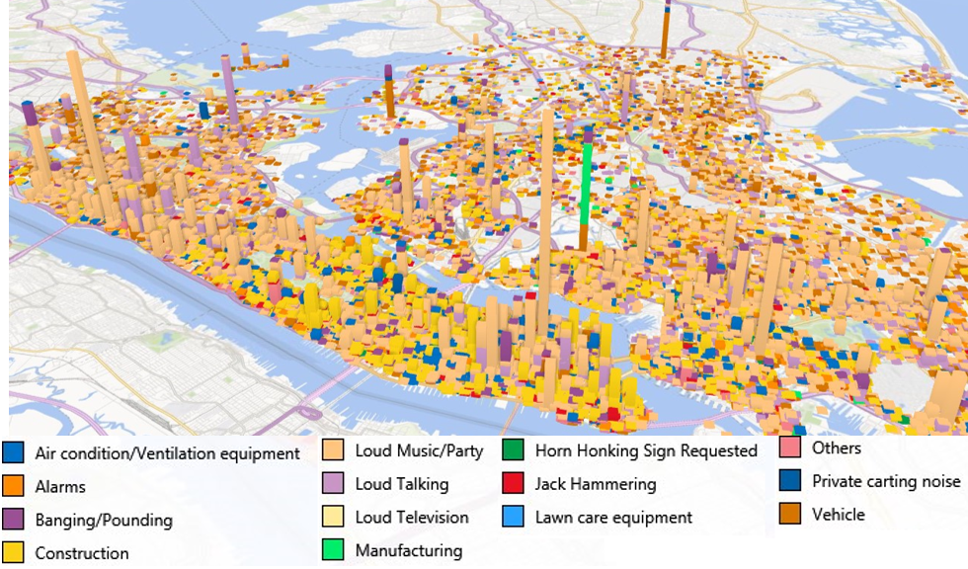
311 in NYC
311 Data
A platform for citizen’s non-emergent complaints
Associated with a location, timestamp, and a category
Human as a sensor → crowd sensing
Implies people’s reaction and tolerance to noises
Notes:
Fortunately, other data sources indicating urban noises are already available.
For example, since 2010, NYC has operated a platform that allows people to call 311 to complain about what they feel annoyed by (without being an emergency) in the city. According to 311 records from 2010 to 2014, the third largest category of complaints has been about urban noises.
When complaining about noises, people are required to provide the location, time and a fine-grained noise category, such as loud music or construction.
This figure visualizes the 311 noise complaints of the past 1 year on Bing map, where different colors stands for different noise categories and the height of a bar denotes the number of 311 complaints made in a region.
the 311 complaint data about noises is actually a result of “human as a sensor” and “crowd sensing”, where each individual contributes their own information about the ambient noises; the individual information can be then aggregated to diagnose the noise pollution throughout a city.
Specifically, the number of 311 calls (about noises) made in a location can be regarded as an indicator of the noise pollution of the location. the more 311 calls are made in a location, the louder the real noise is in the location.
In addition, The noise categories tagged by a complainer can help analyze the composition of noises in a location. The distribution of these 311 complaints over different noise categories may describe the composition of noises in the location.
In short, the 311 data contains rich human intelligence that can help us understand noise pollution from people’s perspectives. It is even better than raw sensor data.

Slide 4
Goal
Reveal the noise situation of each region in each hour
A noise indicator denoting the noisy level
Composition of noises in each location
POIs
Road Networks
Check-ins
311 Data about noises
Notes:
To address this issue, we infer the noise situation of arbitrary regions of NYC, at different time intervals of a day, by combining the historical 311 noise complaint data over a period of time with social media, POIs, and road network data.
Those sources have a correlation with urban noises, providing complementary information to pinpointing urban noises.
For instance, a region with a denser road network is more likely to embrace heavier traffic noises. Likewise, a region with many bars is very likely to generate music noises in the evening. Additionally, a bar with more user check-ins would generate a louder noise.

Slide 5
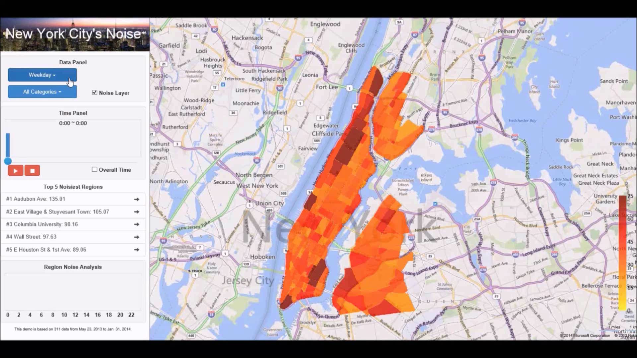
http://citynoise.azurewebsites.net/
Yu Zheng, et al. Diagnosing New York City’s Noises with Ubiquitous Data. UbiComp 2014.

Slide 6
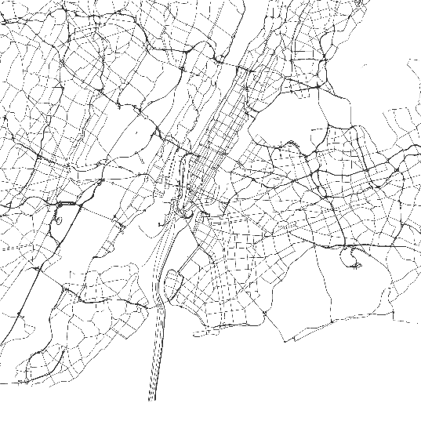
Methodology
Partition NYC into regions by major roads
Build a 3D tensor to model the noises
Sparsity
$$ℒ\left(S,R,C,T\right)=\frac{1}{2}{\left\|𝒜−S×_{R}R×_{C}C×_{T}T\right\|}^{2}+\frac{λ}{2}\left({\left\|S\right\|}^{2}+{\left\|R\right\|}^{2}+{\left\|C\right\|}^{2}+{\left\|T\right\|}^{2}\right)$$
Notes:
We partition a city into disconnected regions by major roads. Then, we can build a three dimension tensor based on the 311 data, where the first dimension…… We divide a day into 24 time slots, i.e. 1 hour per slot. Each entry of the tensor stands for the number of 311 complaints that have been made in a particular region, at a particular time slot and about a particular noise category.
Intuitively, the tensor is very sparse as we do not really have people complaining about noise in each time slot and each region and for each category. E.g., only less than 6 percent of entries are non-zero. If we can fill in the missing entries in the tensor, we can recover the noise situation of arbitrary region and at arbitrary time.
A simple method, data sparse

Slide 7
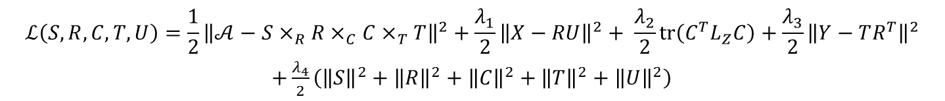
Methodology
311 complaints about noises
POIs and Road Networks
Check-ins
$$ℒ\left(S,R,C,T,U\right)=\frac{1}{2}{\left\|𝒜−S×_{R}R×_{C}C×_{T}T\right\|}^{2}+\frac{λ_{1}}{2}{\left\|X−RU\right\|}^{2}+ \frac{λ_{2}}{2}tr\left(C^{T}L_{Z}C\right)+\frac{λ_{3}}{2}{\left\|Y−TR^{T}\right\|}^{2}$$
$+\frac{λ_{4}}{2}\left({\left\|S\right\|}^{2}+{\left\|R\right\|}^{2}+{\left\|C\right\|}^{2}+{\left\|T\right\|}^{2}+{\left\|U\right\|}^{2}\right)$
Notes:
In our method, we model the historical 311 complaints with a tensor.
A simple method for supplementing the tensor is to use a tensor decomposition, which approximates the tensor with the multiplication of three low rank matrices and a core tensor. However, the tensor is over sparse. So, we need to seek help from other data sources.
Particularly, we can build a matrix x based on POIs and road network data, where a row of the matrix stands for a region and a column denotes a feature, e.g., the number of intersections in the region and distribution of POIs across different categories. Matrix 𝑋 incorporates the similarity between two regions in terms of their geographic features. Intuitively, regions with similar geographic features could have a similar noise situation.
Likewise, we can build another matrix Y based on users check-in data from social networks, where.
Matrix 𝑌 reveals the correlation between different time slots in terms of the distribution of check-ins over different regions. Two time slots sharing a similar user check-in pattern could have a similar noise situation.
$L_{Z}=D−Z$ is the Laplacian matrix of the category correlation graph. which guarantees two (e.g. the $i$th and $j$th) noise categories with a higher similarity (i.e., $Z_{ij}$ is big) should also have a closer distance between the vectors ($c_{i}$ and $c_{j}$) they correspond to in $C$.

Slide 8
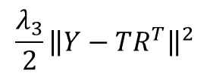
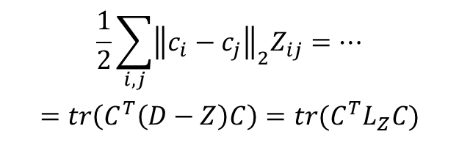

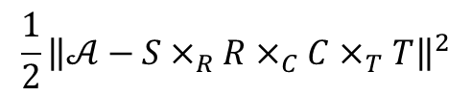
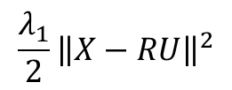
$ℒ\left(S,R,C,T,U\right)=\frac{1}{2}{\left\|𝒜−S×_{R}R×_{C}C×_{T}T\right\|}^{2}+\frac{λ_{1}}{2}{\left\|X−RU\right\|}^{2}+ \frac{λ_{2}}{2}tr\left(C^{T}L_{Z}C\right)+\frac{λ_{3}}{2}{\left\|Y−TR^{T}\right\|}^{2}+\frac{λ_{4}}{2}\left({\left\|S\right\|}^{2}+{\left\|R\right\|}^{2}+{\left\|C\right\|}^{2}+{\left\|T\right\|}^{2}+{\left\|U\right\|}^{2}\right)$
$$\frac{1}{2}{\left\|𝒜−S×_{R}R×_{C}C×_{T}T\right\|}^{2}$$
$$\frac{1}{2}\sum_{i,j}{{\left\|c_{i}−c_{j}\right\|}_{2}Z_{ij}}=…$$
$$=tr\left(C^{T}\left(D−Z\right)C\right)=tr(C^{T}L_{Z}C)$$
U
N
R^{T}
d_{R}
$$\frac{λ_{1}}{2}{\left\|X−RU\right\|}^{2}$$
$$≈$$
L
T
$$\frac{λ_{3}}{2}{\left\|Y−TR^{T}\right\|}^{2}$$
Notes:
In our model, $𝒜$ and $X$ share matrix $R$; $𝒜$ and $Y$ share matrix $R$ and $T$; $L_{Z}$ influences factor matrix $C$. The dense representation of $X$, $Y$ and $Z$ contributes to the generation of a relatively accurate $R$, $C$, and $T$, which reduce the decomposition error of $𝒜$ in turn.
In other words, the knowledge from geographical features, human mobility features, and the correlation between noise categories is propagated into tensor $𝒜$.

Slide 9
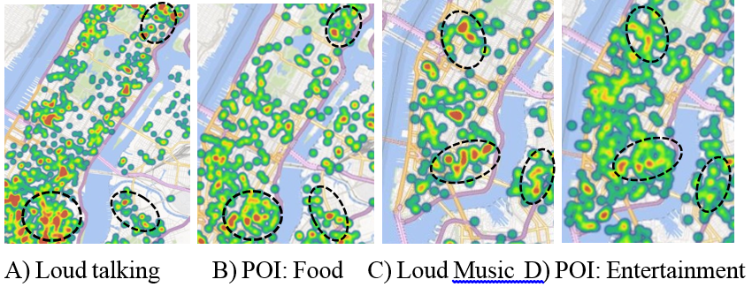
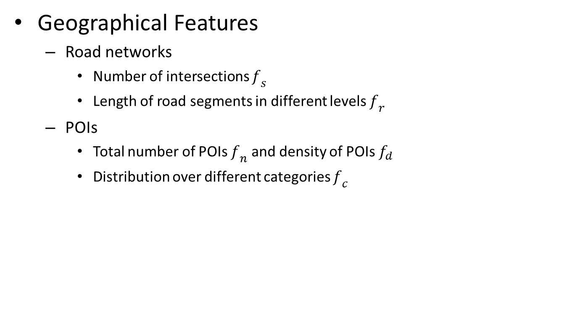
Methodology
Geographical Features
Road networks
Number of intersections $f_{s}$
Length of road segments in different levels $f_{r}$
POIs
Total number of POIs $f_{n}$ and density of POIs$f_{d}$
Distribution over different categories $f_{c}$

Slide 10
Methodology
Check in data in NYC
Gowalla: 127,558 check-ins (4/24/2009 to 10/13/2013)
Foursquare: 173,275 check-ins (5/5/2008 to 7/23/2011)
Correlation with noises
Y implies
correlation between different time slots
correlation between different regions

Slide 11
Methodology
Correlation between different noise categories

Slide 12
Experiment
Datasets
Data sets | Period | Scales
311 noise data | 5/23/2013-1/31/2014 | 67,378; 14 categories
Foursquare | 4/24/2009-10/13/2013 | 173,275
Gowalla | 5/5/2008-7/23/2011 | 127,558
POIs | 2013 | 26,884; 15 categories
Road Network | 2013 | 87,898 nodes, 91,649 edges

Slide 13
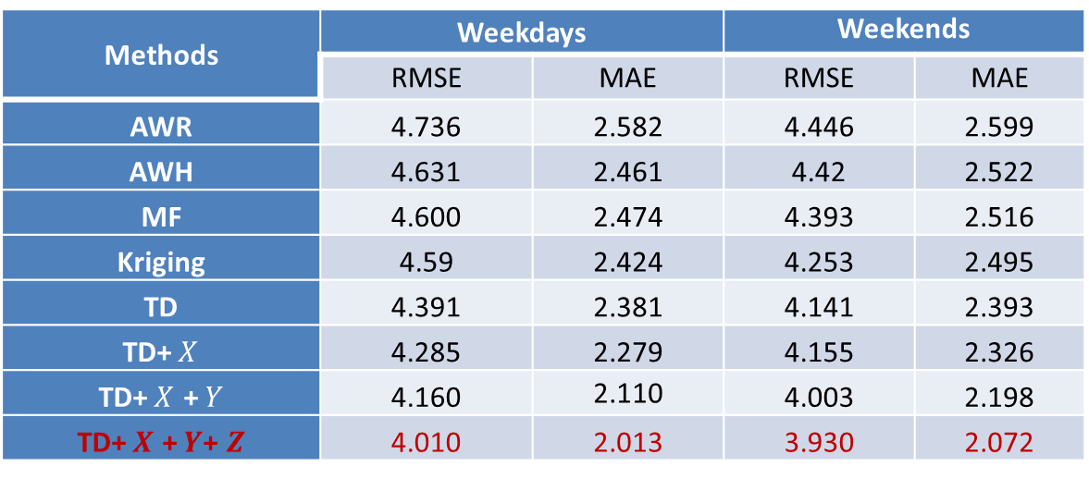
Experiments
Accuracy of the inferences
Remove 30% non-zero entries
Metrics: RMSE & MAE
Methods | Weekdays |  | Weekends
 | RMSE | MAE | RMSE | MAE
AWR | 4.736 | 2.582 | 4.446 | 2.599
AWH | 4.631 | 2.461 | 4.42 | 2.522
MF | 4.600 | 2.474 | 4.393 | 2.516
Kriging | 4.59 | 2.424 | 4.253 | 2.495
TD | 4.391 | 2.381 | 4.141 | 2.393
TD+$X$ | 4.285 | 2.279 | 4.155 | 2.326
TD+$X$ +$Y$ | 4.160 | 2.110 | 4.003 | 2.198
TD+$X$ +$Y$+ $Z$ | 4.010 | 2.013 | 3.930 | 2.072
Yu Zheng, et al. Diagnosing New York City’s Noises with Ubiquitous Data. UbiComp 2014.

Slide 14
Experiments
Relative ranking performance
Ranked by the inferred noise indicators
Ground truth: measured by a mobile phone running a client program
Metric: NDCG

Slide 15
Results
311 vs. Inferences
2.75% of entries on weekdays are from 311 data (97.25% by inference)
1.83% of entries on weekends are from 311 data (98.17% by inference)

Slide 16
Conclusion
311 data helps reveal the noise situation of the city but not accurately enough
Fusing other data sources is important
Spatio-temporal correlation between noises of different locations and time slots
The data and client are publicly available !

Slide 17
Search for “CityNoise Microsoft”
Thanks!
Yu Zheng
yuzheng@microsoft.com
Homepage
The data and client are publicly available !

Slide 18
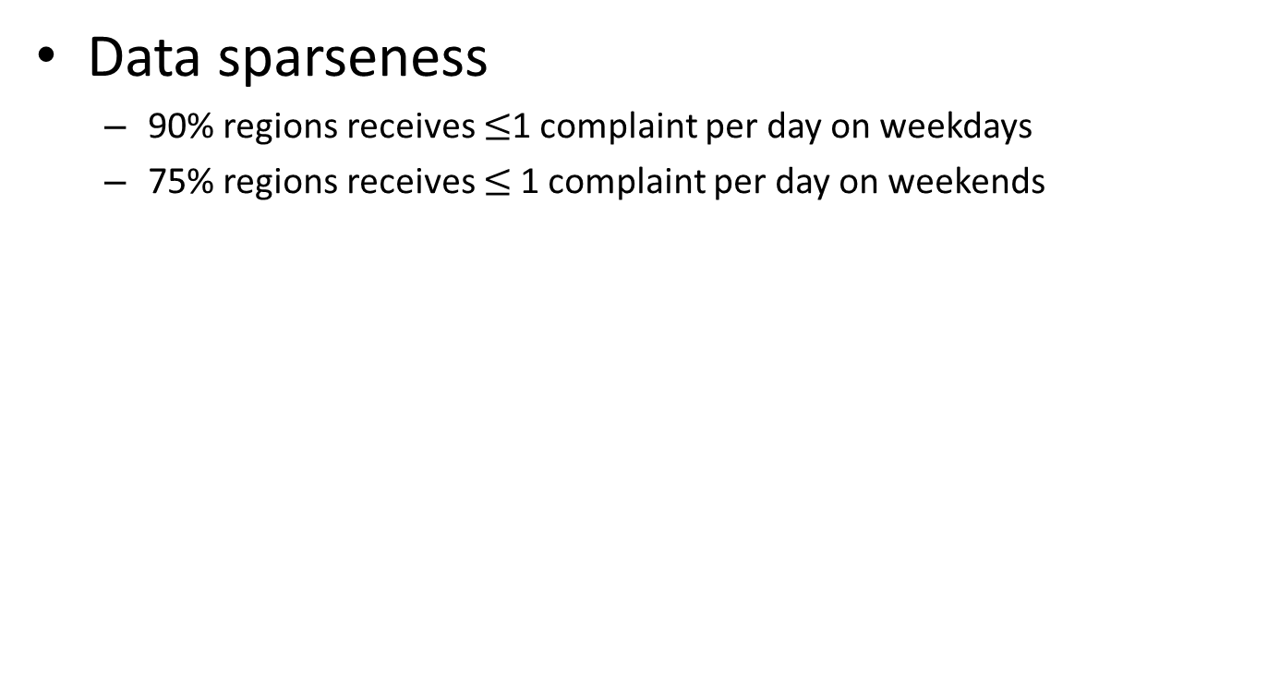
311 in NYC
Data sparseness
90% regions receives $≤$1 complaint per day on weekdays
75% regions receives $≤$1 complaint per day on weekends
68 weekdays

Slide 19
Results
Overall noise situation in NYC
Weekdays and weekends
Different time of days
Example
Wall Street, central park,
Time square, NYU, Columbia

Slide 20
Results
Noises of particular categories
Yu Zheng, et al. Diagnosing New York City’s Noises with Ubiquitous Data. UbiComp 2014.

Slide 21
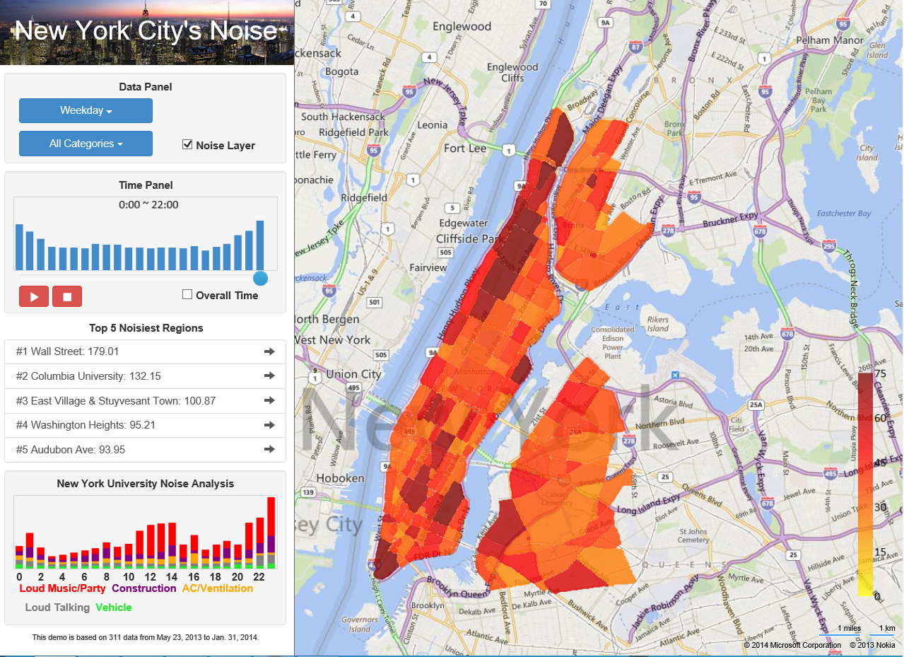

Slide 22
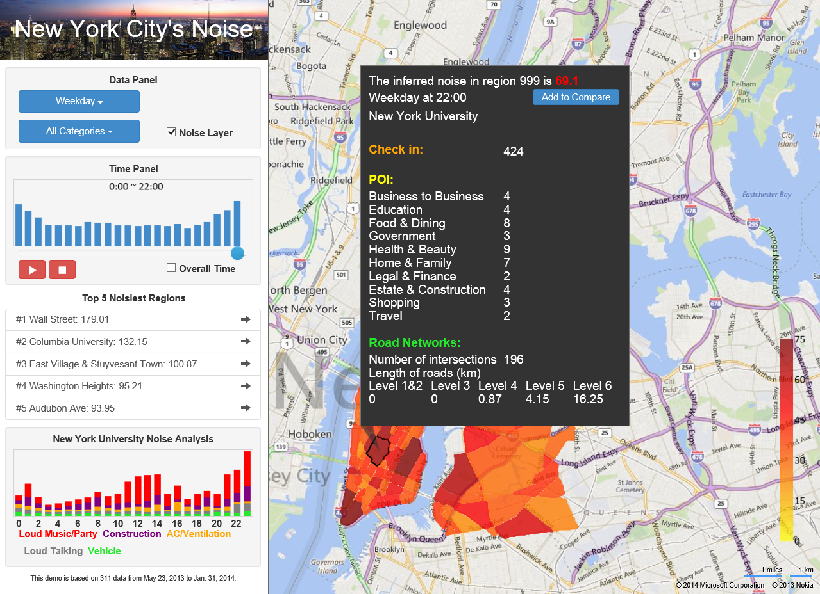

Slide 23
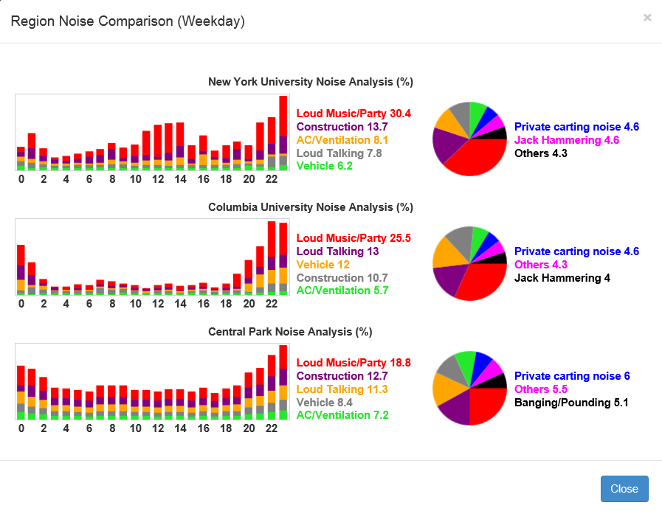

Slide 24
311 in NYC
Correlation between 311 complaints and real noise levels
Measured the real noise levels of 36 locations in Manhattan
People’s tolerances vary in time of day
Notes:
To prove the concept, we collect the real noise level of 36 locations in Manhattan by using a mobile phone; 24 locations were measured during daytime and 12 locations at nigh.
As shown in the two figures, the horizontal axis denotes the number of complaints and the vertical axis denotes the real noise level. A marker stands for one location.
Generally speaking, the more the 311 calls are made in a location, the higher the real noise level is. However, there are two stories that we need to pay attention to.
First, there are some locations (marked by the red circles shown) having very few 311 complaints but still with considerable real noises. This is caused by the sparsity of 311 complaint data, e.g. 90% regions receives $≤$1 complaint per day on weekdays. Intuitively, we cannot have people reporting their ambient noise situation at anytime and any location. But, having no complaint records does not mean no noise.
Second, we can see people complain more about noise at night even though the real noise level of the location is level than during the daytime. That is to say, we need to model the noise pollution of different times respectively, considering people’s reaction to the noise.
Recovering the noise situation of locations that do not have sufficient 311 data remains a challenge.

